Slide 1
Learnings From the Articles of Digital Entrepreneurship
Dr. S. K. Majumdar

Slide 2
Salient Points of Article 3
This Article answer One Critical Question:
What makes Entrepreneurs Entrepreneurial?

Slide 3
Salient Points of Article 3
According to Author Entrepreneurial Thinking is:
Not causal reasoning (often used by researchers, Many to One).
Imaging Possible New (Possible) Ends by using a given set of means, which authors defines as Effectual Reasoning (Many to Many).
Effectual reasoning is inherently creative.
Effectual reasoning demands – imagination, spontaneity, risk-taking and salesmanship.

Slide 4
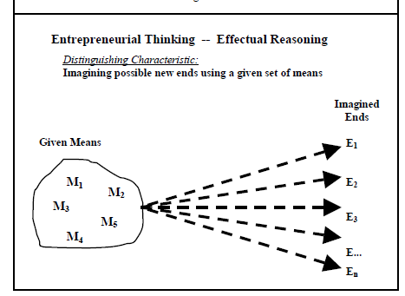
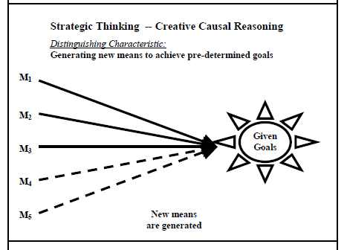
Causal Vs. Effectual Reasoning
Understand the Needs and Pains of Target Customer
Many to 1
Many to Many

Slide 5
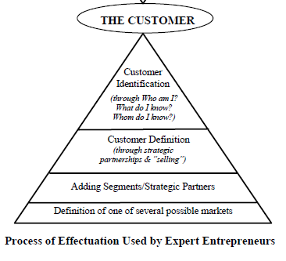
Lifecycle Model of Digital Entrepreneurship
Customer Discover + Findings of Ways of Wining
Driving
Innovation
Radical
Process Innovation
Design Thinking
The Iterative Front End of Digital Entrepreneurship
Concept
Business Development
Platform
Innovation
Design Criteria
Prototype
Market Entry
Idea
Digital
Platform
Enterprise Building
Customer
Discovery
Customer
Winning
Business Model Actuation
Building STAR Teams
Realigning TEAM with Growth Strategy
Vibrant Digital
Enterprise
Product/ Service Development
Business Model Development
Fight Rivalry
Sustain Growth
Platform
Up-gradation
Fuzzy Front
End of Design
Pivoting
Digital Process
Back End of Digital Entrepreneurship
S = Strategic
T = Transformational
A = Agile, and
R = Responsive
T = Task, Talents and Executive Leadership
E = Engagement and Exploration
A = Alignment and Accountability
M = Measurement and Management
Digital Ecosystems
Innovation to Orchestration to Value Optimization
Source: Dr. S. K. Majumdar

Slide 6
Author’s Advice
Do not assume pre-existing market
Actions that fulfil Human Aspiration is a successful venture.
All aspirations are not explicit. Many are hidden.
He who has penetrating eyes and sharp nail can seize them.

Slide 7

Thank You

